Slide 1
Security Hardening Strategy
Depending upon the size and type of the organization, there will be dozens, hundreds, or even thousands of IT assets to secure
Priority is a key factor in all security undertakings
Prioritize what is most important and needs to be done first
Cascade as we go along

Slide 2
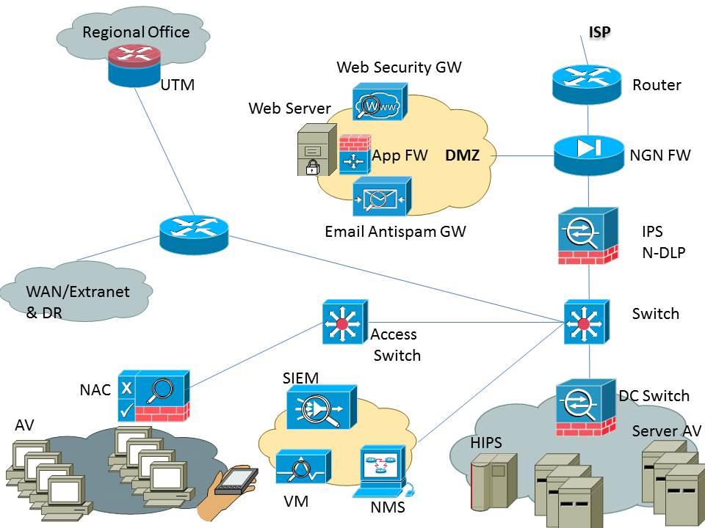
Security Hardening Strategy

Slide 3
Security Hardening Strategy
Separate security engineering (Step 3) from security hardening (step 1)
Security engineering requires more thorough working so will slow down the security implementation
Do the low hanging fruit first (security hardening)

Slide 4
Security Hardening Strategy
Minumum security baseline (MSB) refers to the obvious assets which need to be secured and the threshold which is the minimum expectation from the security program

Slide 5
Security Hardening Strategy

Slide 6
Security Hardening Strategy
TRACK 1: IT INFRASTRUCTURE
TRACK 2: ISMS DOC & PROCESSES
TRACK 3: SOFTWARE APP
TRACK 4: OTHER APPS/UTILITIES/3RD PARTIES
TRACK 5: DESKTOPS & BROWSERS
TRACK 6: VULNERABILITY MANAGEMENT
TRACK 7: MOBILE SECURITY

Slide 7
Security Hardening Strategy
For a successful security transformation project, good planning, organization, and effective project management is essential

